Slide 1



Operational research for urban solar development
“PV failure detection based on operational time series”
13/11/2023 - Morning
Alexandre Mathieu

Slide 2
Agenda
Curriculum
Audience
PV performance model steps

Slide 3
Curriculum
Initial plan
Day | Time | Duration | Content
Monday 13/11/2023 | 8h-9h30 9h45-11h15 | 1h30 + 1h30 | 50% Lecture / 50 % Hands-on
Monday 27/11/2023 | 9h45-11h15 12h30-14h | 1h30 + 1h30 | 50% Lecture / 50 % Hands-on
Friday 01/12/2023 | 8h-11h 13h15-16h15 | 6h | 25% Lecture / 75 % Hands-on / Project
Thursday 07/12/2023 | 8h-11h 12h45-15h45 | 6h | 10% Lecture / 90 % Project
Friday 22/12/2023 | 8h-9h30 | 1h30 | 100 % Project

Slide 4
Curriculum
Content
PV performance modeling from weather variables (Irradiance in the plane of array, ambient temperature etc..) and system configuration, which includes:
Module temperature
DC power
AC/DC efficiency
Performance metric calculations.
Failure detection based on real production time series.
Hands-on with python notebooks.

Slide 5
Curriculum
15%[4] of underperformances: « Recoverable » Energy: 5%[4,5]
Complex in-situ O & M: No one-fit-all O&M[2] Expensive[3]
PV capacity increases exponentially
+20%/year worldwide since 2010[1]
Motivations
[1] Masson, G., Kaizuka, I., 2021. Trends in Photovoltaic Applications (IEA-PVPS T1-41:2021). IEA PVPS
[2] U. Jahn et al., ‘Guidelines for Operation and Maintenance of Photovoltaic Power Plants in Different Climates’, IEA, Technical Report IEA-PVPS T13-07:2022, Oct. 2022. [3] « Coûts et rentabilités du grand photovoltaïque en métropole continentale », CRE, 2019
[4] Leloux, J., Narvarte, L., Trebosc, D., 2011. Performance analysis of 10,000 residential PV systems in France and Belgium. Presented at the 26th European Photovoltaic Solar Energy Conference and Exhibition, Hamburg, Germany.) [5] Raycatch, ‘Solar Asset Optimization, Industry Benchmark Study’, Tel Aviv, Israel, Feb. 2021.

Slide 6
Curriculum
Objectives
At the end of this course, you should be able to:
Perform data treatment and analysis with Python on operational PV time series.
Model and calculate the performance of a PV installation.
Detect and quantify underperformances.

Slide 7
Audience

Slide 8

Audience
You
Background
PV modeling
Python
Notes:
Where do you come from ? Education
Expérience with python and PV modeling

Slide 9
Agenda
Curriculum
Audience
PV performance model steps

Slide 10

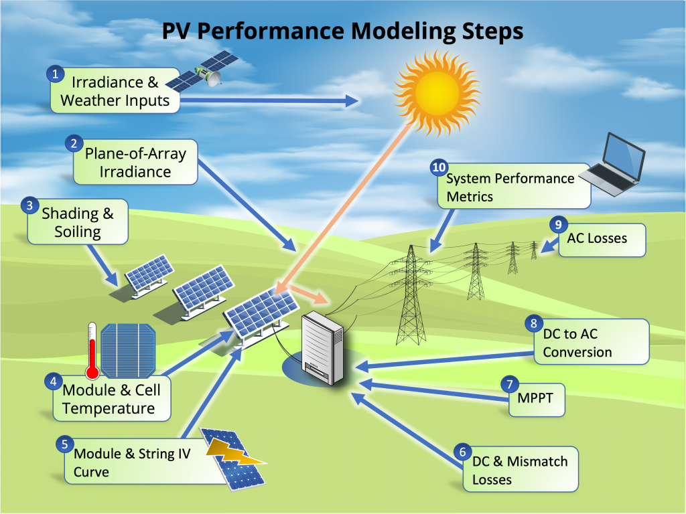
Modeling steps
*image from: PVSC48 python tutorial

Slide 11
Modeling steps
Weather data: Irradiance, ambient temperature, humidity, rain, snow…

Slide 12
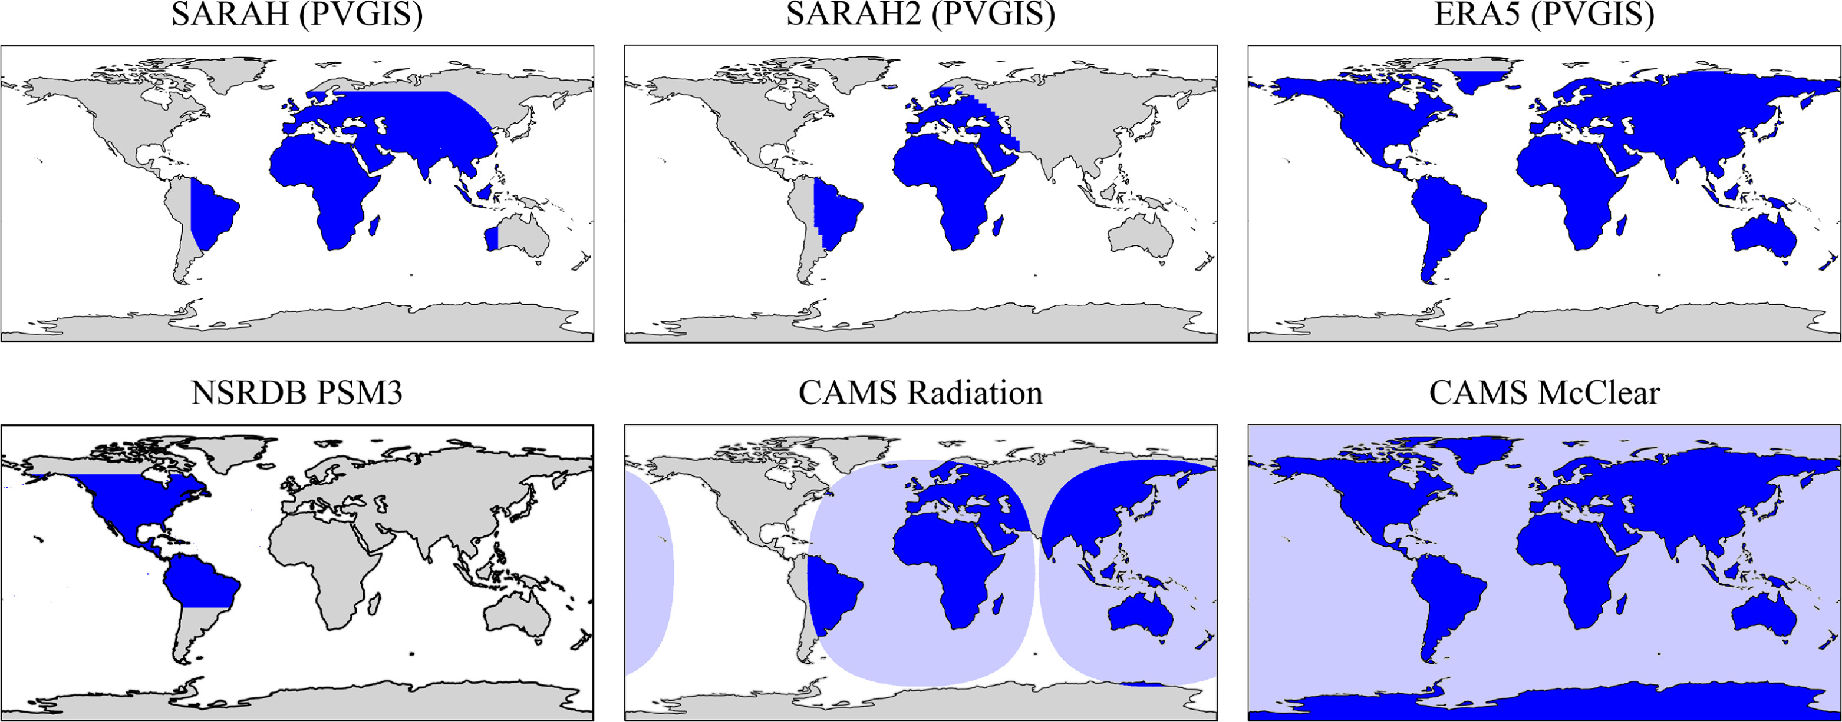
Modeling steps
Some Irradiance datasets, supported by pvlib [1]
Weather data:
Irradiance, measured in W/m2, with max instantaneous values around 1000 W/m2 is obtained from:
Satellite data (CAMS, NSSRDB, SolarGis…)
[1] Adam R. Jensen, Kevin S. Anderson, William F. Holmgren, Mark A. Mikofski, Clifford W. Hansen, Leland J. Boeman, Roel Loonen,
pvlib iotools—Open-source Python functions for seamless access to solar irradiance data, Solar Energy, 2023

Slide 13
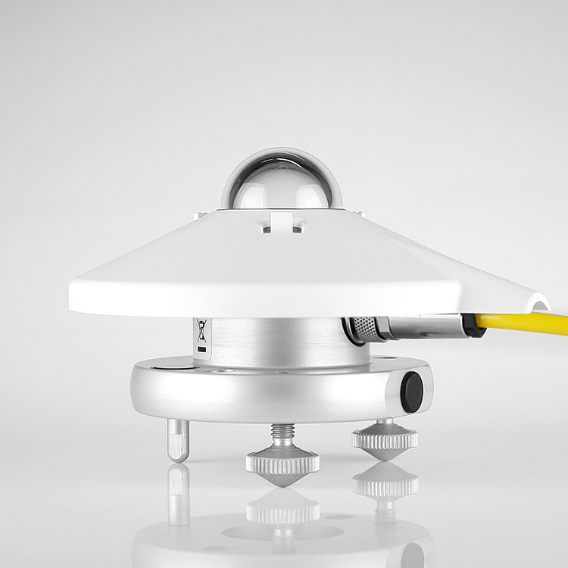
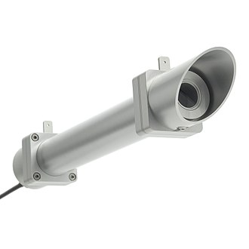
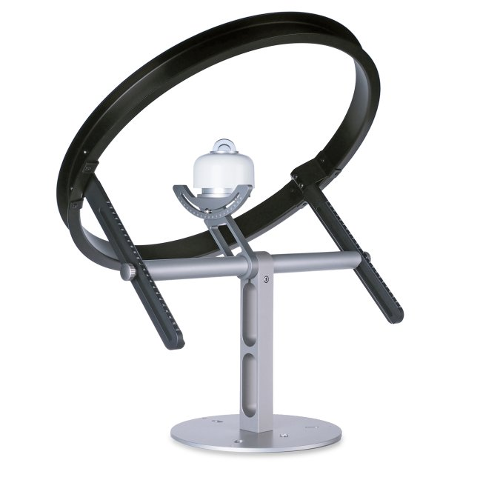
Modeling steps
Weather data:
Irradiance, measured in W/m2, is obtained from:
Satellite data (CAMS, NSSRDB, SolarGis…)
In-situ instrumentations
(Hukseflux product)
Pyranometer: Global/Inclined Irradiance
Pyrheliometer: Direct irradiance
Pyranometer with shadow ring: Diffuse Irradiance

Slide 14
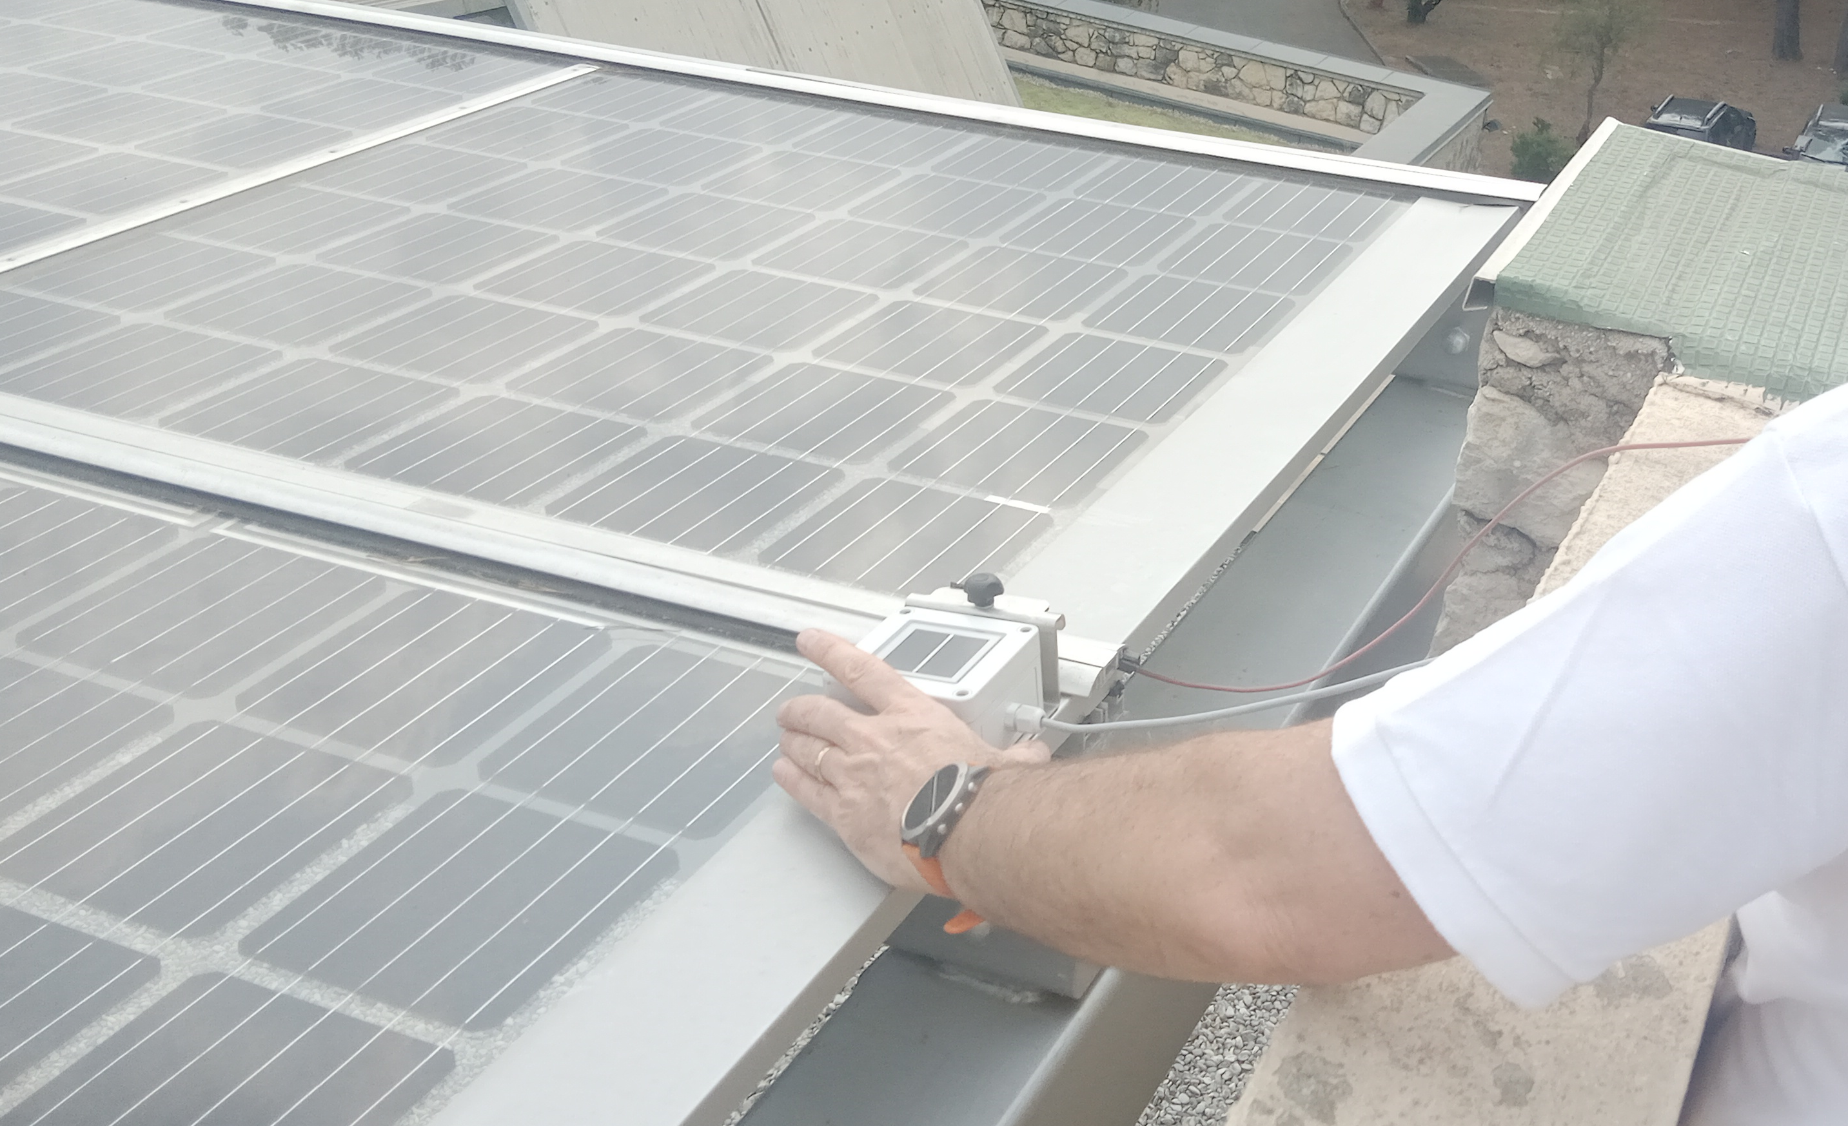
Modeling steps
Weather data:
Irradiance, measured in W/m2, is obtained from:
Satellite data (CAMS, NSSRDB, SolarGis…)
In-situ instrumentations
Reference cell: Inclined Irradiance (without reflection/spectral effects)

Slide 15
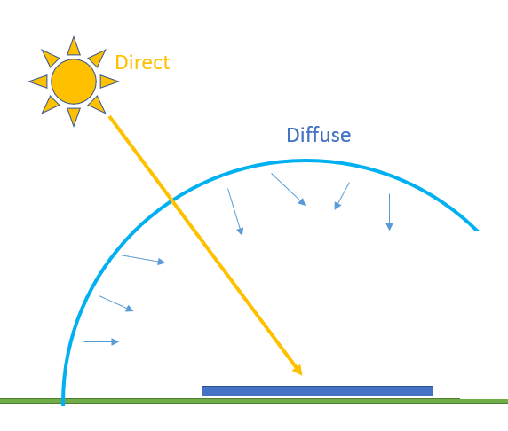
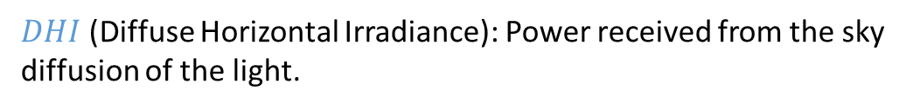
Modeling steps
Weather data
Reminder, the Global Horizontal Irradiance (GHI) can be broken down into 2 components (ignoring reflections from other surrounding elements):
$$GHI=BHI+DHI$$
*image from PVSC48 tutorial
$BHI$ (Beam Horizontal Irradiance): Power received from the Beam of the sun on the horizontal plan.
$DHI$ (Diffuse Horizontal Irradiance): Power received from the sky diffusion of the light.

Slide 16
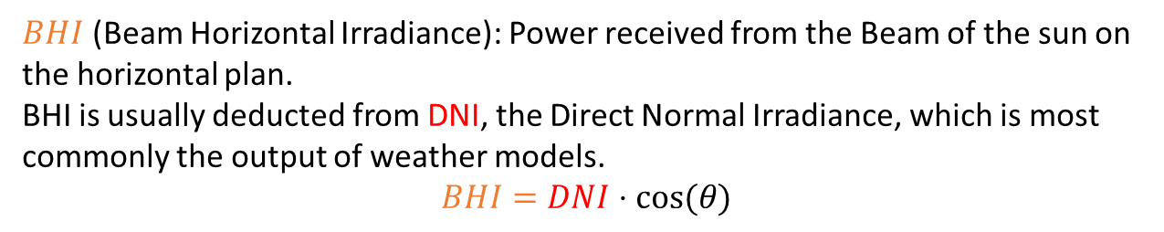
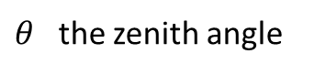
Modeling steps
Weather data
Reminder, the Global Horizontal Irradiance (GHI) can be broken down into 2 components (ignoring reflections from other surrounding elements):
$θ$ the zenith angle
$$GHI=BHI+DHI$$
*image adapted from PVSC48 tutorial
$BHI$ (Beam Horizontal Irradiance): Power received from the Beam of the sun on the horizontal plan. BHI is usually deducted from DNI, the Direct Normal Irradiance, which is most commonly the output of weather models. $$BHI=DNI⋅cos⁡(θ)$$
$DHI$ (Diffuse Horizontal Irradiance): Power received from the sky diffusion of the light.

Slide 17
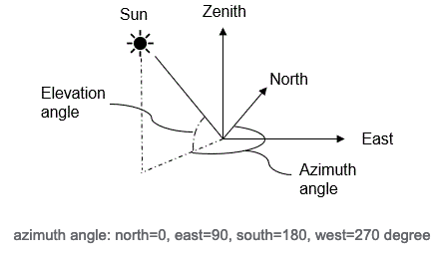
Modeling steps
Weather data:
Sun path
z
Φ
Image: https://www.prairielittlebighouse.com/prairie-blog/archives/03-2021

Slide 18
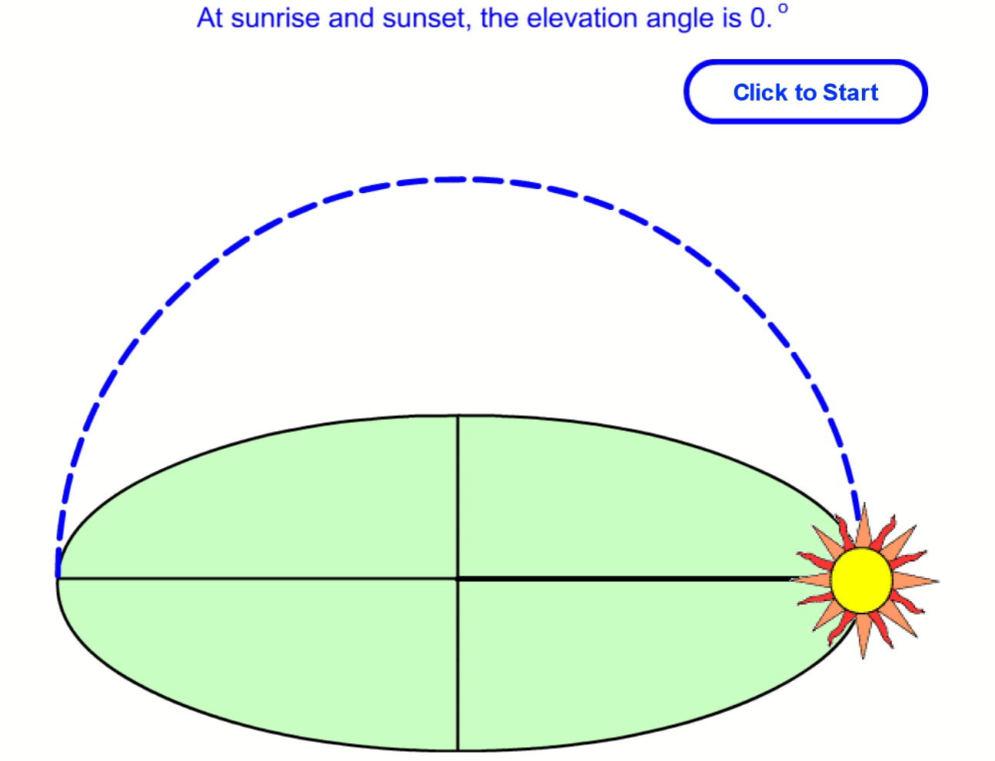
Modeling steps
z
Φ
Weather data:
The sun path is characterized by:
z [°], elevation angle, height of the sun in the sky
*animation from pveducation

Slide 19
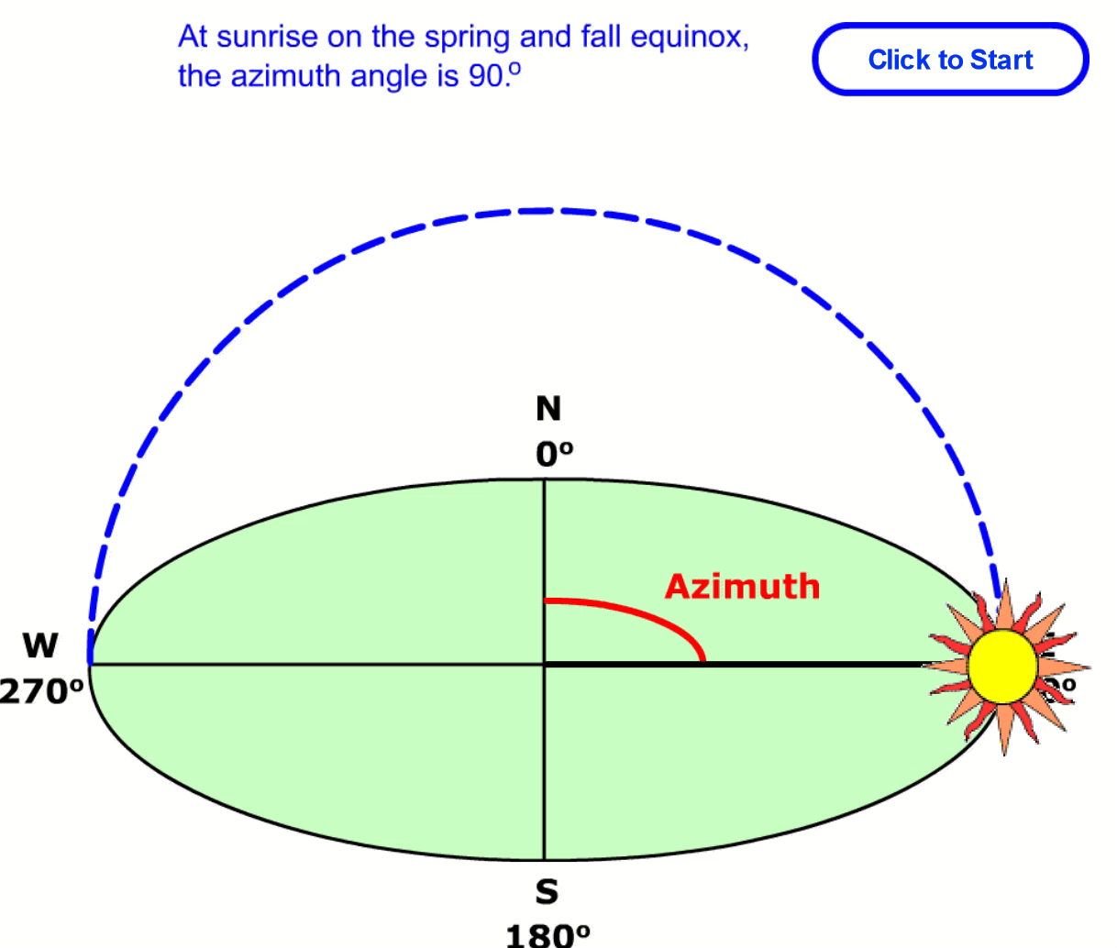
Modeling steps
z
Φ
Weather data:
The sun path is characterized by:
z [°], elevation angle, height of the sun in the sky
Φ [°], the azimuth angle: angle of sun between north and sun direction
*animation from pveducation
*animation from pveducation

Slide 20
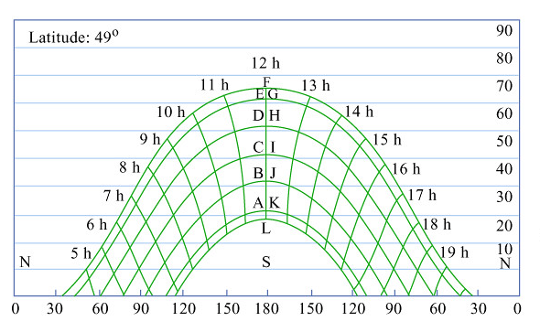
Modeling steps
Typical sun path diagram
Weather data:
The sun path is characterized by:
z [°], elevation angle, height of the sun in the sky
Φ [°], the azimuth angle: angle between north and the sun direction
z [°]
Φ [°]

Slide 21
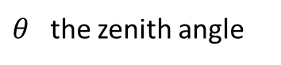
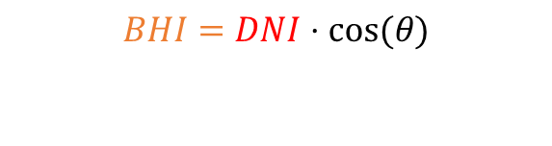

Modeling steps
z
Φ
Weather data:
The sun path is characterized by:
z [°], elevation angle, height of the sun in the sky
Φ [°], the azimuth angle: angle between north and the sun direction
Remember ? To calculate BHI:
$$BHI=DNI⋅cos⁡(θ)$$
$θ$ the zenith angle
With $θ$, the zenith angle
$$θ=90° −z$$
*image adapted from PVSC48 tutorial

Slide 22
Modeling steps
2. Plan-of-Array Irradiance
Reminder, the Global Plane-Of-Array (GPOA) irradiance can be calculated from DHI, GHI and DNI.

Slide 23
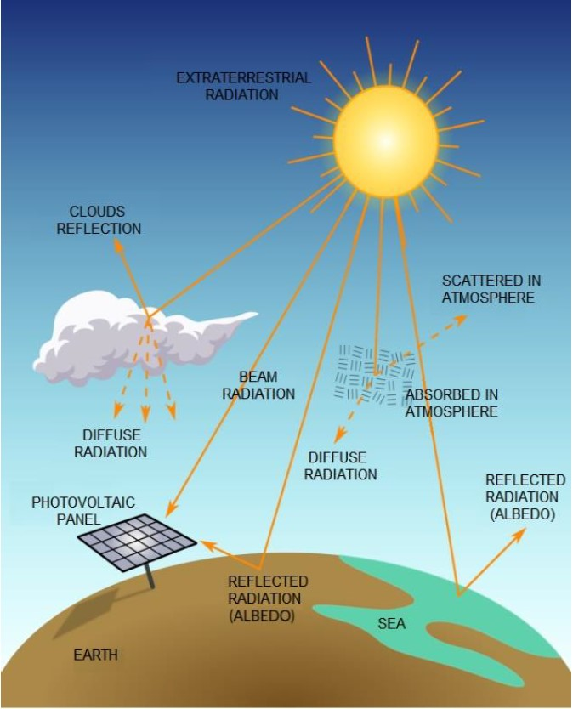
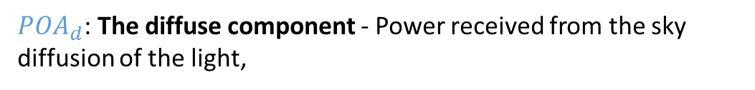

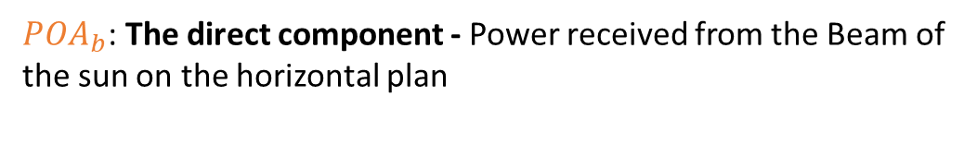
Modeling steps
2. Plan-of-Array Irradiance
Reminder, the Global Plane-Of-Array (GPOA) irradiance can be calculated from DHI, GHI and DNI and are broken down into 3 components:
$$GPOA=POA_{b}+POA_{d}+POA_{grd}$$
$POA_{b}$: The direct component - Power received from the Beam of the sun on the horizontal plan
$POA_{d}$: The diffuse component - Power received from the sky diffusion of the light,
$POA_{grd}$: The ground-reflected component - Power received from reflections from the ground
Souza, Muriele et al. (2019). Determination of Diffused Irradiation from Horizontal Global Irradiation - Study for the City of Curitiba.

Slide 24
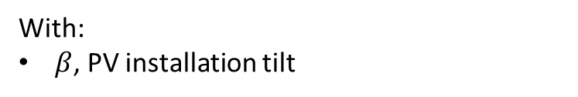
Modeling steps
2. Plan-of-Array Irradiance
Reminder, the Global Plane-Of-Array (GPOA) irradiance can be calculated from DHI, GHI and DNI and are broken down into 3 components:
$$GPOA=POA_{b}+POA_{d}+POA_{grd}$$
$POA_{b}=DNI⋅\cos\left(AOI\right)$
Under the isotropic/no-shading assumption
$POA_{d}=DHI⋅\frac{1+cos⁡(β)}{2}$
$POA_{grd}=GHI⋅ρ⋅\frac{1−cos⁡(β)}{2}$
Souza, Muriele et al. (2019). Determination of Diffused Irradiation from Horizontal Global Irradiation - Study for the City of Curitiba.
With:
$β$, PV installation tilt

Slide 25
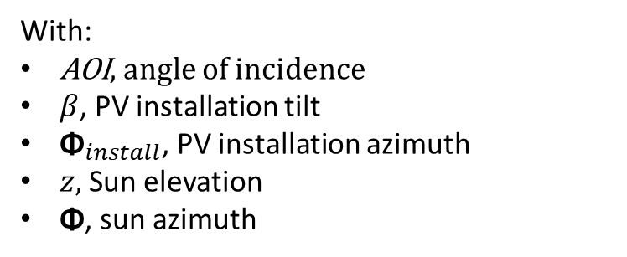

Modeling steps
2. Plan-of-Array Irradiance
Reminder, the Global Plane-Of-Array (GPOA) irradiance can be calculated from DHI, GHI and DNI and are broken down into 3 components:
$$GPOA=POA_{b}+POA_{d}+POA_{grd}$$
$POA_{b}=DNI⋅\cos\left(AOI\right)$
$\cos\left(AOI\right)$ = $\left[\cos\left(β\right)∙\sin\left(z\right)+\sin\left(β\right)∙\cos\left(z\right)∙cos⁡(\text{Φ}−{\text{Φ}}_{install})\right]$
Under the isotropic/no-shading assumption
With:
AOI, angle of incidence
$β$, PV installation tilt
${\text{Φ}}_{install}$, PV installation azimuth
$z,$Sun elevation
$\text{Φ}$, sun azimuth
$POA_{d}=DHI⋅\frac{1+cos⁡(β)}{2}$
$POA_{grd}=GHI⋅ρ⋅\frac{1−cos⁡(β)}{2}$

Slide 26

Modeling steps
2. Plan-of-Array Irradiance
Use the notebook: https://github.com/AlexandreHugoMathieu/pvfault_detection_solar_academy/blob/master/notebooks/python_intro_poa.ipynb
Follow the python tutorial and calculate the 3 POA components for:
One timestep
Over one year
Time for some hands-on exercises

Slide 27
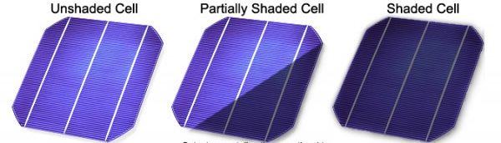
Modeling steps
3. Shading
Shadow can come from near and far elements and their impact can be distinguished into two categories
Partial shading refers to a condition where some but not all of the solar cells or panels in a PV array are exposed to sunlight while others are shaded.
Full shading occurs when the entire PV array is covered and deprived of direct sunlight.
*https://mcisolutions.ca/effect-of-shade-on-solar-panels/

Slide 28
Modeling steps
3. Shading
Shadow can come from near and far elements and their impact can be distinguished into two categories
Partial shading refers to a condition where some but not all of the solar cells or panels in a PV array are exposed to sunlight while others are shaded.
Full shading occurs when the entire PV array is covered and deprived of direct sunlight.
Not treated in this course but, in average, if a PV panel is around 8% covered, the whole PV panel is bypassed and then, do not produce.
Demonstrated in one of pvlib example: https://pvlib-python.readthedocs.io/en/stable/gallery/shading/plot_partial_module_shading_simple.html
*https://mcisolutions.ca/effect-of-shade-on-solar-panels/

Slide 29
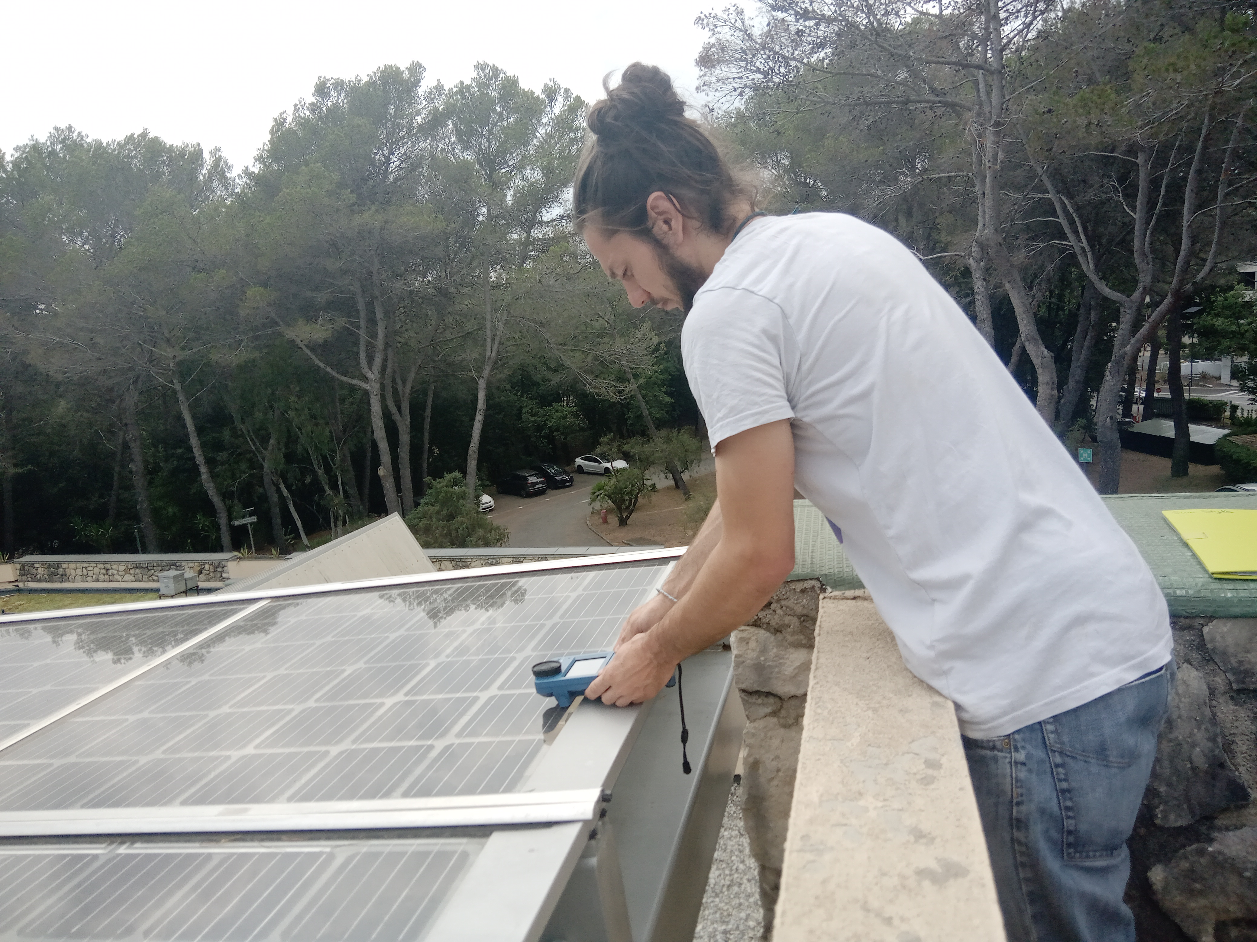
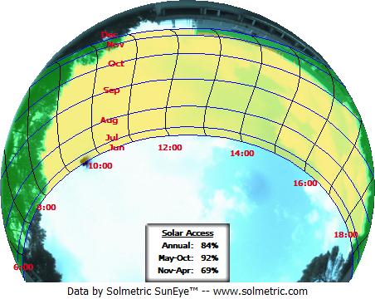
Modeling steps
Fisheye camera
3. Shading
The Fisheye camera enables to account for the in-situ (full) shading in PV modeling.
South
East
West
North
Example in South of France

Slide 30
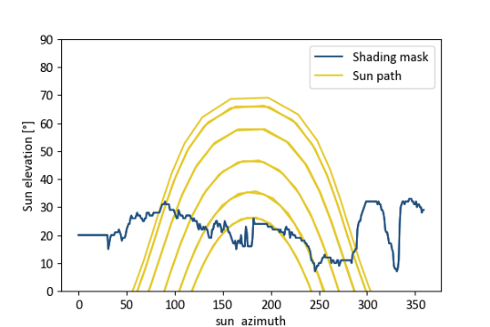
Modeling steps
Fisheye camera
3. Shading
The Fisheye camera enables to account for the in-situ (full) shading in PV modeling.
South
East
West
North
Example in South of France

Slide 31
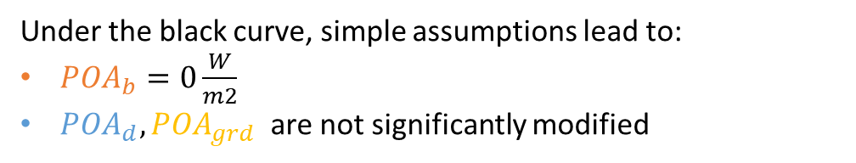
Modeling steps
3. Shading
The Fisheye camera enables to account for the in-situ (full) shading in PV modeling.
Under the black curve, simple assumptions lead to:
$POA_{b}=0\frac{W}{m2}$
$POA_{d}, POA_{grd}$ are not significantly modified
South
East
West
North
Example in South of France

Slide 32
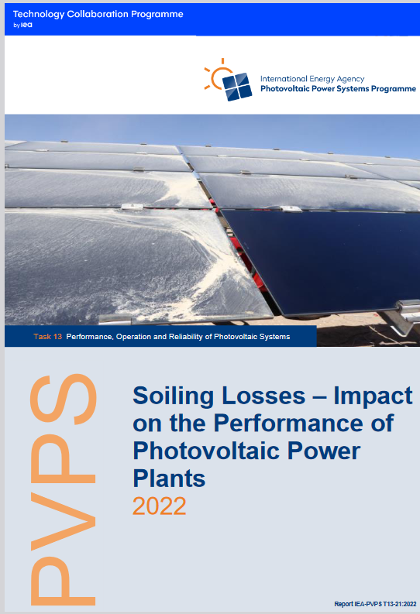
Modeling steps
3. Soiling losses
Big subject in the PV industry:
Report of 130 pages on PV soiling: IEA PVPS, Soiling Losses – Impact on the Performance of Photovoltaic Power Plants 2022

Slide 33
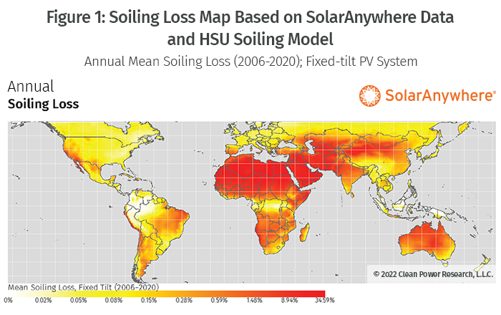
Modeling steps
3. Soiling losses
Can roughly be ignored in France according to the HSU model.
Model HSU: M. Coello and L. Boyle, "Simple Model for Predicting Time Series Soiling of Photovoltaic Panels, Sept. 2019.

Slide 34
Modeling steps
3. Shading / Terrain horizon mask
Time for some hands-on exercises,
Again!

Slide 35
Modeling steps
3. Shading / Terrain horizon mask
PVGIS: Website/Online Tool to estimate power production:
Enables to extract the horizon mask with a Digital Surface Model (DSM).
Go to: https://re.jrc.ec.europa.eu/pvg_tools/en/
Time for some hands-on exercise's,
Again !

Slide 36
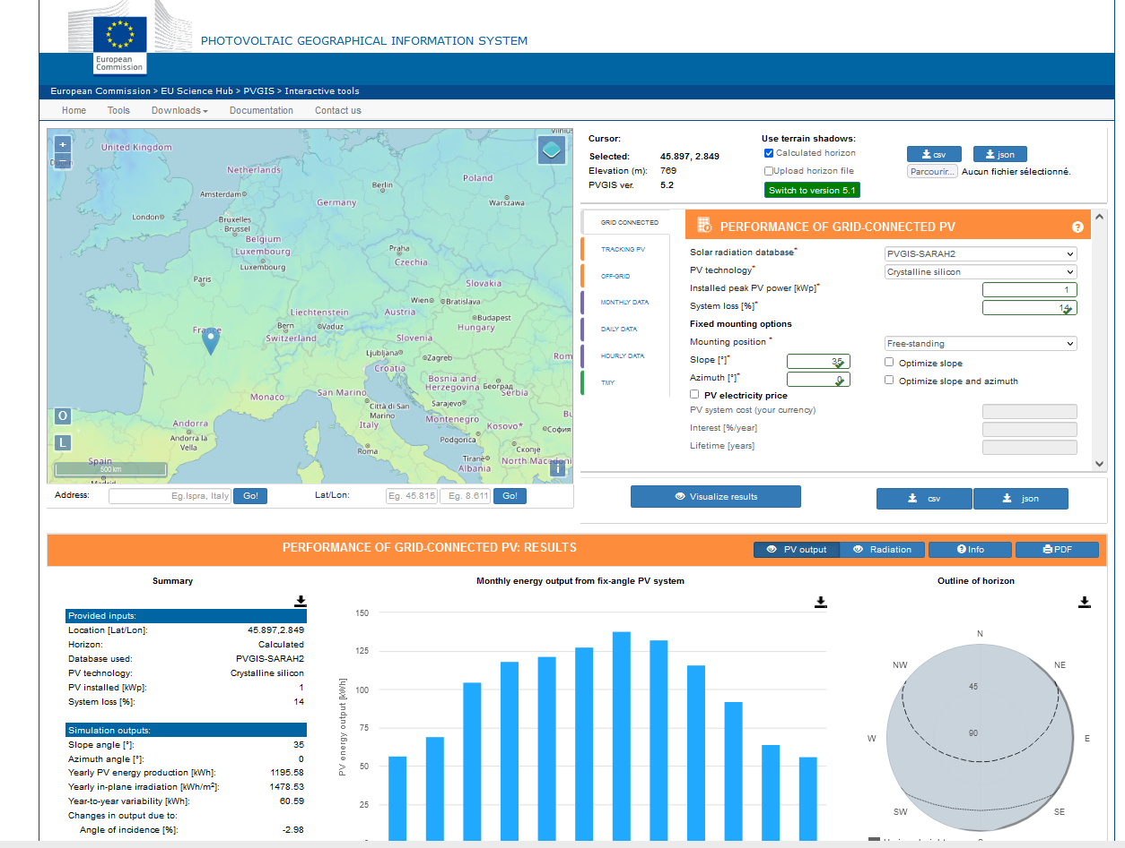
Modeling steps
3. Shading / Terrain horizon mask
PVGIS: Website/Online Tool to estimate power production: https://re.jrc.ec.europa.eu/pvg_tools/en/
Enables to extract the horizon mask with a Digital Surface Model (DSM).
Instructions:
Generate a simulation on PVGIS
Click on the map on Grenoble and select the « Grid connected tab »
Vizualize
Extract the horizon file in csv format
2. Follow the instructions on the jupyter notebook and calculate the modified POA on one year. https://github.com/AlexandreHugoMathieu/pvfault_detection_solar_academy/blob/master/notebooks/python_intro2_horizon_mask.ipynb
Notes:
Show function
Create function to get the API horizon mask
How many hours is the direct component blocked ?

Slide 37
Modeling steps
4. Module and Cell temperature
The hotter a module is, the less efficient it is !

Slide 38
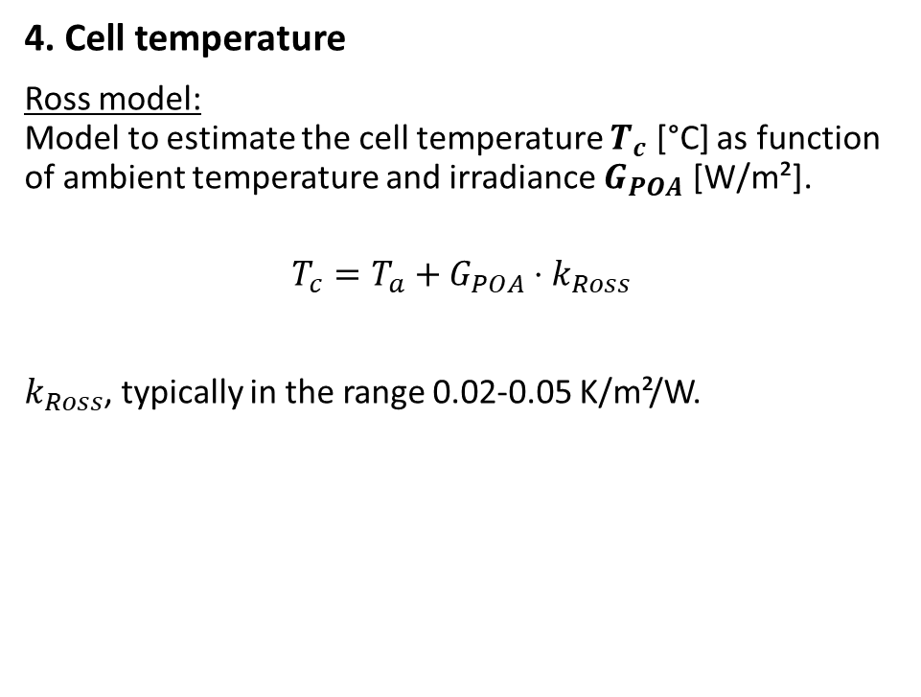
Modeling steps
4. Cell temperature
Ross model: Model to estimate the cell temperature $T_{c}$ [°C] as function of ambient temperature and irradiance $G_{POA}$ [W/m²].
$$T_{c}=T_{a}+G_{POA}⋅k_{Ross}$$
$k_{Ross}$, typically in the range 0.02-0.05 K/m²/W.
Ross, R. G. Jr., (1981). “Design Techniques for Flat-Plate Photovoltaic Arrays”

Slide 39
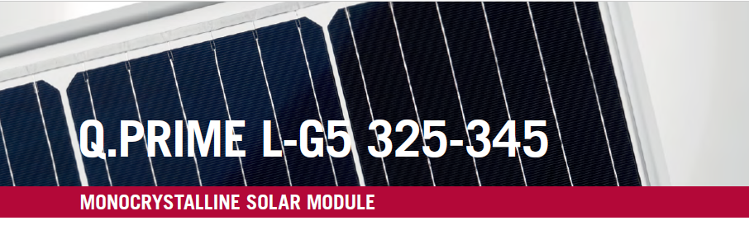
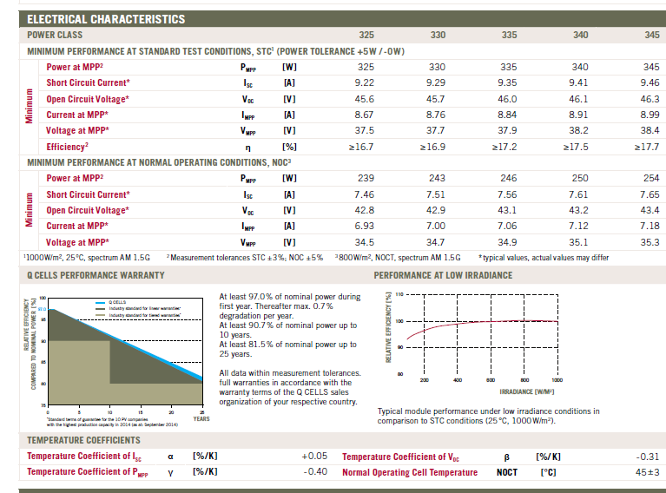
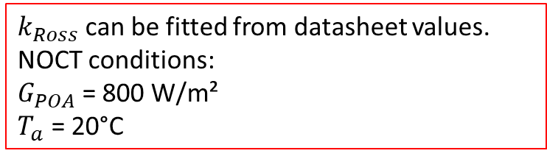
Modeling steps
$k_{Ross}$can be fitted from datasheet values. NOCT conditions: $G_{POA}$= 800 W/m²
$T_{a}$ = 20°C
4. Cell temperature
Ross model: Model to estimate the cell temperature $T_{c}$ [°C] as function of ambient temperature and irradiance $G_{POA}$ [W/m²].
$$T_{c}=T_{a}+G_{POA}⋅k_{Ross}$$
$k_{Ross}$, typically in the range 0.02-0.05 K/m²/W.
Ross, R. G. Jr., (1981). “Design Techniques for Flat-Plate Photovoltaic Arrays”

Slide 40
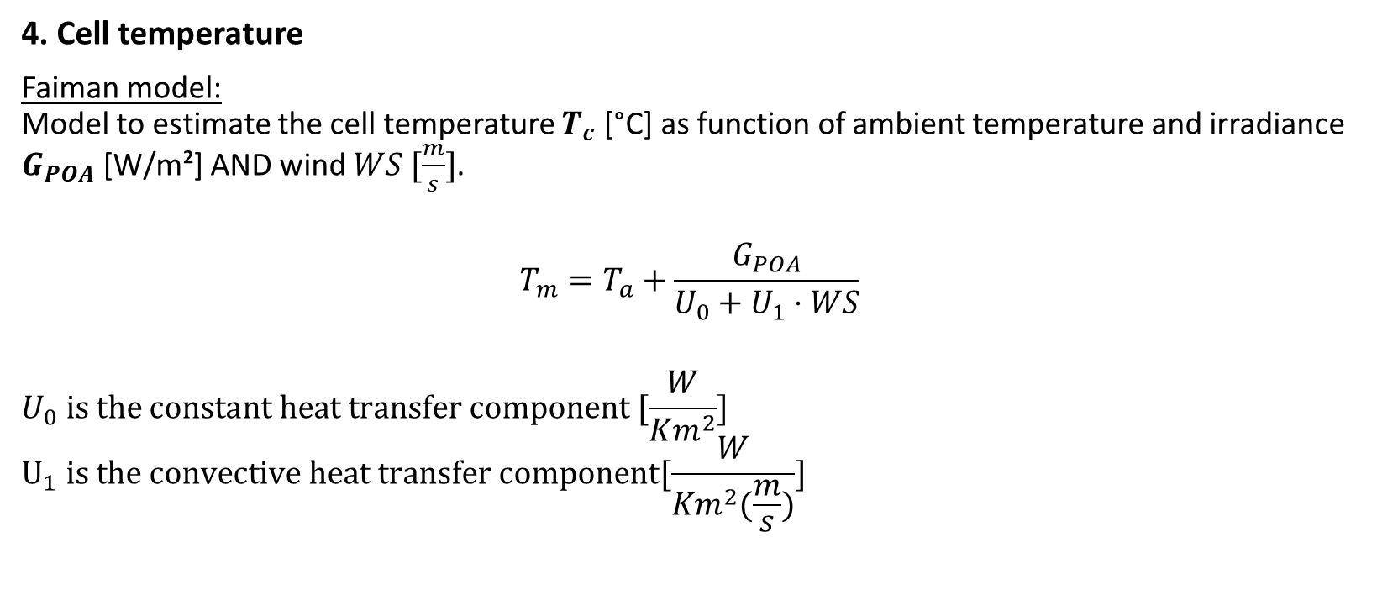
Modeling steps
4. Cell temperature
Faiman model: Model to estimate the cell temperature $T_{c}$ [°C] as function of ambient temperature and irradiance $G_{POA}$ [W/m²] AND wind $WS [\frac{m}{s}]$.
$$T_{m}=T_{a}+\frac{G_{POA}}{U_{0}+U_{1}⋅WS}$$
$$U_{0} is the constant heat transfer component [\frac{W}{Km^{2}}]$$
$$U_{1} is the convective heat transfer component[\frac{W}{Km^{2}(\frac{m}{s})}]$$
Faiman, D. (2008). Assessing the outdoor operating temperature of photovoltaic modules.

Slide 41
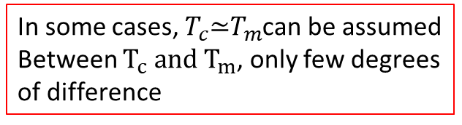
Modeling steps
4. Cell temperature
Faiman model: Model to estimate the cell temperature $T_{c}$ [°C] as function of ambient temperature and irradiance $G_{POA}$ [W/m²] AND wind $WS [\frac{m}{s}]$.
$$T_{m}=T_{a}+\frac{G_{POA}}{U_{0}+U_{1}⋅WS}$$
$$U_{0} is the constant heat transfer component [\frac{W}{Km^{2}}]$$
$$U_{1} is the convective heat transfer component[\frac{W}{Km^{2}(\frac{m}{s})}]$$
In some cases, $T_{c}\text{≃}T_{m}$can be assumed Between $T_{c} and T_{m}$, only few degrees of difference
Faiman, D. (2008). Assessing the outdoor operating temperature of photovoltaic modules.

Slide 42
Modeling steps
Time for some hands-on exercises !
4. Cell temperature
Use the following notebook: https://github.com/AlexandreHugoMathieu/pvfault_detection_solar_academy/blob/master/notebooks/dc_power_estimation.ipynb
Follow the python tutorial and estimate the cell temperature for one year.

Slide 43
Modeling steps
5. Module and String IV Curve

Slide 44
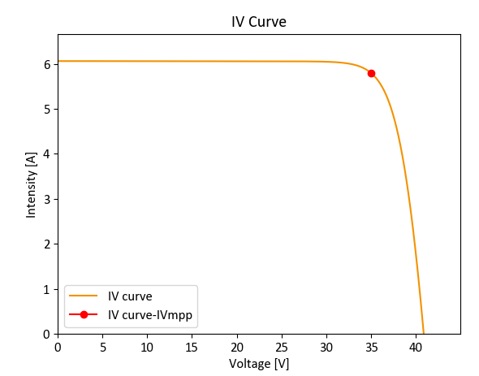
Modeling steps
5. Module and String IV Curve
For a fixed irradiance and module temperature, the PV module has its I, current which depends on V, voltage and it can take many operating points.

Slide 45
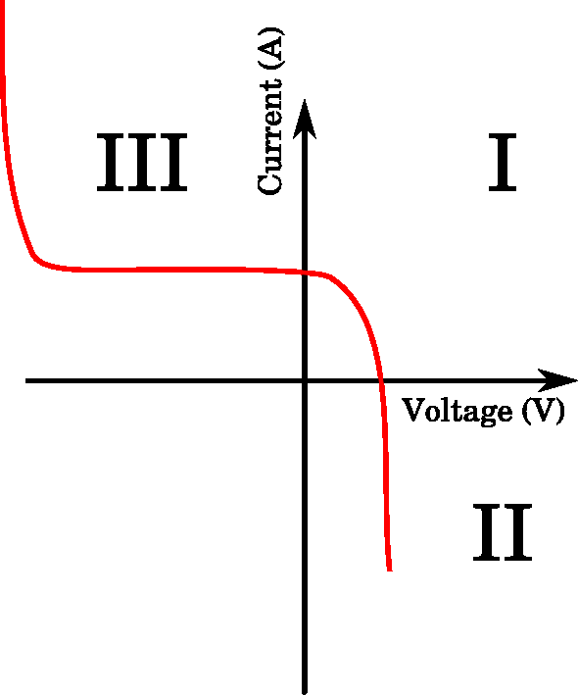
Modeling steps
5. Module and String IV Curve
For a fixed irradiance and module temperature, the PV module has its I, current which depends on V, voltage and it can take many operating points
In reality, the IV characteristics go out of the 1st quadrant and the module can potentially consume power.

Slide 46
Modeling steps
5. Module and String IV Curve
For a fixed irradiance and module temperature, the PV module has its I, current which depends on V, voltage and it can take many operating points
Then, the inverter is constantly searching for the operating. point which maximizes the power MPP: Maximum Power Point.

Slide 47
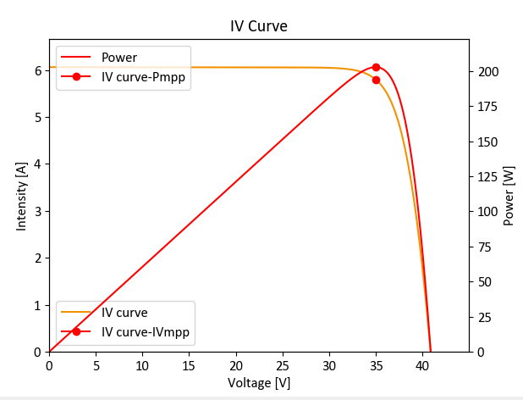
Modeling steps
5. Module and String IV Curve
For a fixed irradiance and module temperature, the PV module has its I, current which depends on V, voltage and it can take many operating points.
Then, the inverter is constantly searching for the operating. point which maximizes the power MPP: Maximum Power Point.
Especially, it changes the voltage with the MPP-Tracker (MPPT) to maximize power.

Slide 48
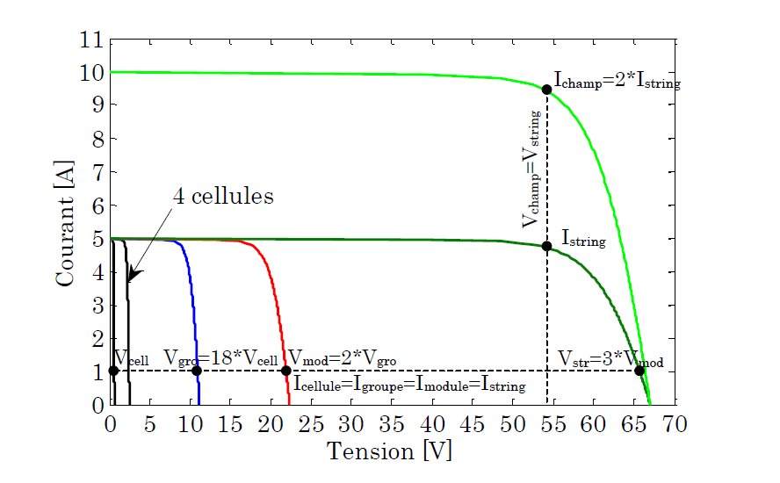
Modeling steps
5. Module and String IV Curve
By the way… the IV curves can be summed up when the modules are connected in series or parallel! The inverter, then, maximizes the power of the PV array IV curve.
Bun, L.. “Détection et localisation de défauts pour un système PV.” (2011).

Slide 49
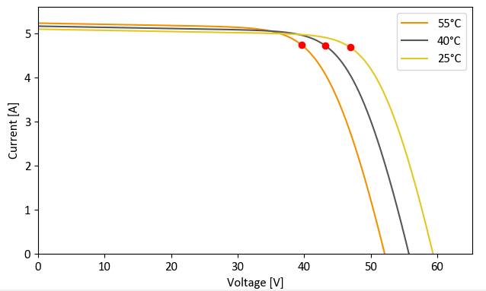
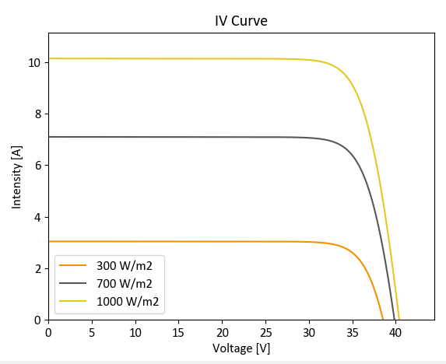
Modeling steps
Example of I-V curves as function of different module temperature
5. Module and String IV Curve
The IV curves' dependencies:
Higher cell temperatures mostly decrease the voltage
Higher irradiance level mostly increase the current
Example of I-V curves as function of different irradiances

Slide 50
Modeling steps
6. DC & Mismatch Losses
Not the focus of this class. However, keep in mind that:
DC wiring losses are around 0.5%-2%.
Mismatch losses refer to the fact that PV modules have different IV curves and this can entail significant losses.

Slide 51
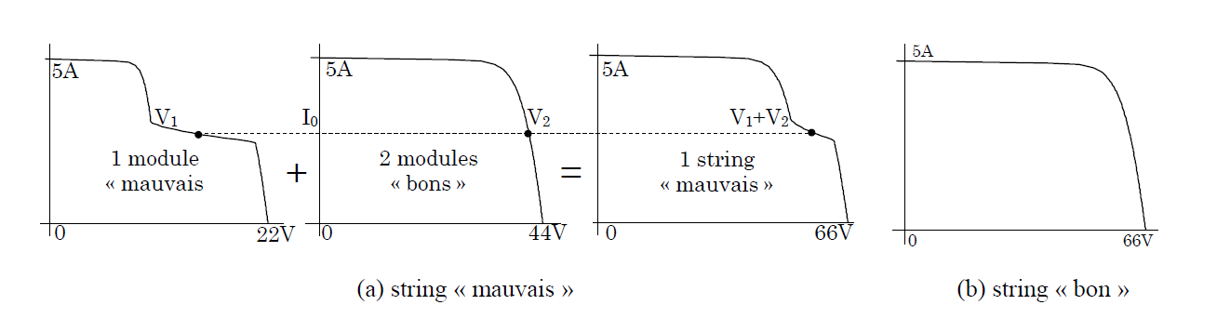
Modeling steps
6. DC & Mismatch Losses
Not the focus of this class. However, keep in mind that:
DC wiring losses are around between 0.5% and 2%.
Mismatch losses refers to the fact that PV modules have different IV curves and this can entail significant losses. For instance, if one of them has a very degraded IV curve (shading or other), it can significantly degrade the IV curve at the array level.
Bun, L.. “Détection et localisation de défauts pour un système PV.” (2011).

Slide 52
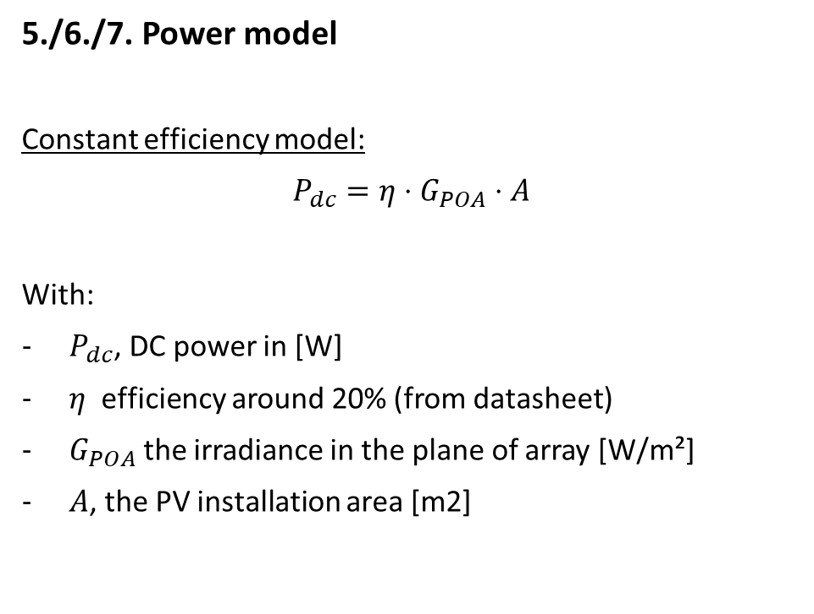
Modeling steps
5./6./7. Power model
Constant efficiency model:
$P_{dc}=η⋅G_{POA}⋅A$
With:
$P_{dc}$, DC power in [W]
$η$ efficiency around 20% (from datasheet)
$G_{POA}$ the irradiance in the plane of array [W/m²]
$A$, the PV installation area [m2]

Slide 53

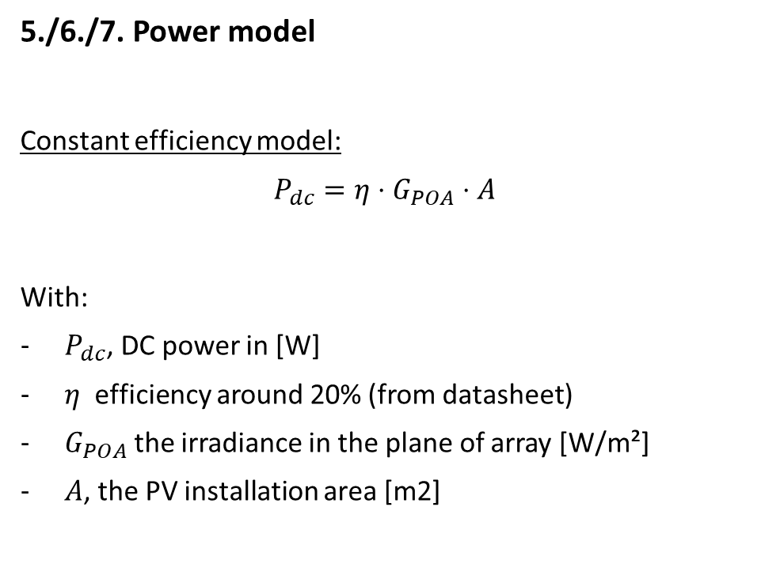
Modeling steps
5./6./7. Power model
Constant efficiency model:
$P_{dc}=η⋅G_{POA}⋅A$
With:
$P_{dc}$, DC power in [W]
$η$ efficiency around 20% (from datasheet)
$G_{POA}$ the irradiance in the plane of array [W/m²]
$A$, the PV installation area [m2]
Not really precise for instantaneous values

Slide 54
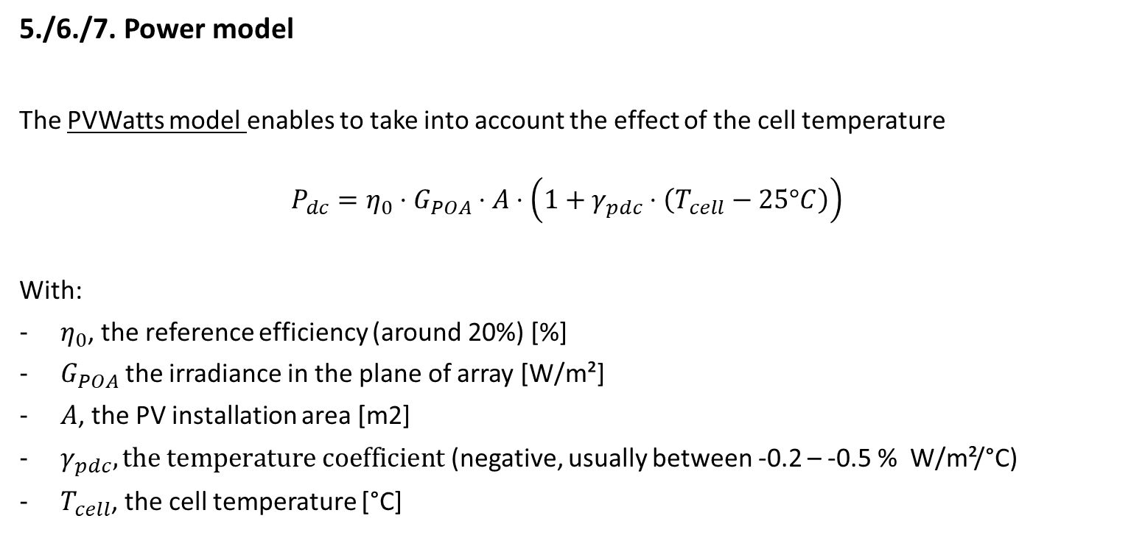
Modeling steps
5./6./7. Power model
The PVWatts model enables to take into account the effect of the cell temperature
$$P_{dc}=η_{0}⋅G_{POA}⋅A⋅\left(1+γ_{pdc}⋅\left(T_{cell}−25°C\right)\right)$$
With:
$η_{0}$, the reference efficiency (around 20%) [%]
$G_{POA}$ the irradiance in the plane of array [W/m²]
$A$, the PV installation area [m2]
$γ_{pdc}, the temperature coefficient$ (negative, usually between -0.2 – -0.5 % W/m²/°C)
$T_{cell}$, the cell temperature [°C]
PVWatts model: A. P. Dobos, “PVWatts Version 5 Manual” (2014).

Slide 55
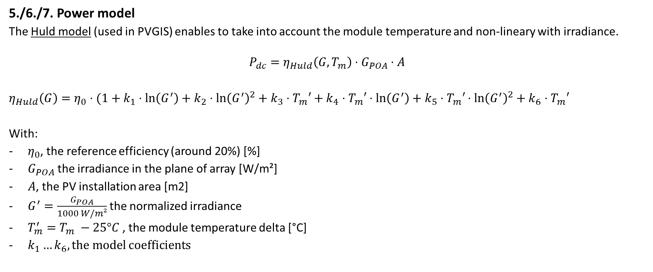
Modeling steps
5./6./7. Power model
The Huld model (used in PVGIS) enables to take into account the module temperature and non-lineary with irradiance.
$$P_{dc}=η_{Huld}\left(G, T_{m}\right)⋅G_{POA}⋅A$$
$η_{Huld}\left(G\right)=η_{0}⋅(1+k_{1}⋅\ln\left(G^{′}\right)+k_{2}$ $⋅\ln{{\left(G^{′}\right)}^{2}+k_{3}⋅T_{m}′+k_{4}⋅T_{m}′⋅\ln\left(G^{′}\right)+k_{5}⋅T_{m}′}$ $⋅\ln{{\left(G^{′}\right)}^{2}+k_{6}⋅T_{m}′}$
With:
$η_{0}$, the reference efficiency (around 20%) [%]
$G_{POA}$ the irradiance in the plane of array [W/m²]
$A$, the PV installation area [m2]
$G^{′}=\frac{G_{POA}}{1000 W/m²}$ the normalized irradiance
$T_{m}^{′}=T_{m} −25°C$ , the module temperature delta [°C]
$k_{1}…k_{6}, the model$coefficients
Huld model: Thomas Huld et al., A power-rating model for crystalline silicon PV modules, 2011,

Slide 56
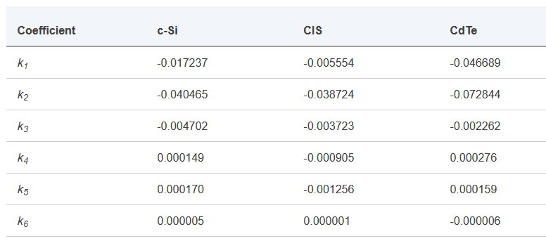
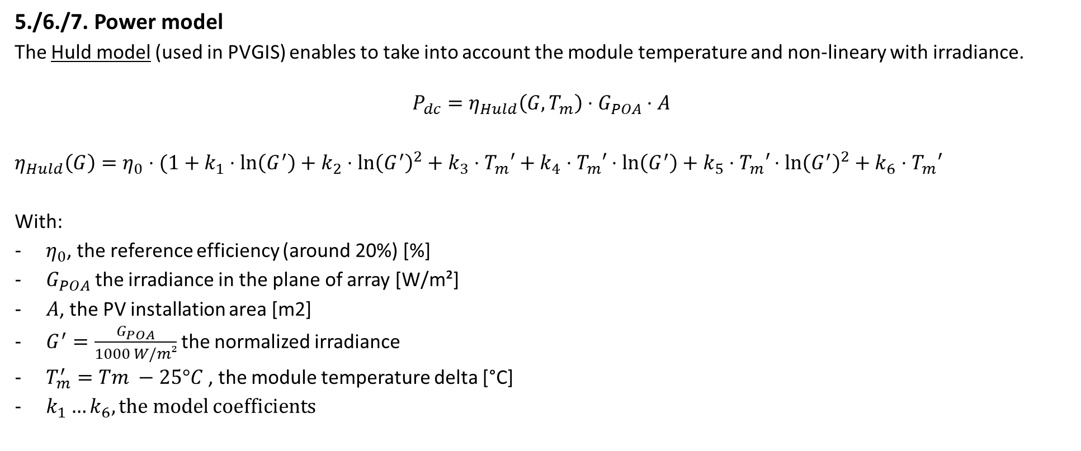
Modeling steps
5./6./7. Power model
The Huld model (used in PVGIS) enables to take into account the module temperature and non-lineary with irradiance.
$$P_{dc}=η_{Huld}\left(G, T_{m}\right)⋅G_{POA}⋅A$$
$η_{Huld}\left(G\right)=η_{0}⋅(1+k_{1}⋅\ln\left(G^{′}\right)+k_{2}$ $⋅\ln{{\left(G^{′}\right)}^{2}+k_{3}⋅T_{m}′+k_{4}⋅T_{m}′⋅\ln\left(G^{′}\right)+k_{5}⋅T_{m}′}$ $⋅\ln{{\left(G^{′}\right)}^{2}+k_{6}⋅T_{m}′}$
With:
$η_{0}$, the reference efficiency (around 20%) [%]
$G_{POA}$ the irradiance in the plane of array [W/m²]
$A$, the PV installation area [m2]
$G^{′}=\frac{G_{POA}}{1000 W/m²}$ the normalized irradiance
$T_{m}^{′}=Tm −25°C$ , the module temperature delta [°C]
$k_{1}…k_{6}, the model$coefficients
Reference values from PVGIS
Huld model: Thomas Huld et al., A power-rating model for crystalline silicon PV modules, 2011,

Slide 57
Modeling steps
5./6./7. Power model
Use the following notebook: https://github.com/AlexandreHugoMathieu/pvfault_detection_solar_academy/blob/master/notebooks/dc_power_estimation.ipynb
Follow the python tutorial and estimate the DC power for one year.
Time for some hands-on exercises !

Slide 58
Resources
Modeling guide PVPMC: https://pvpmc.sandia.gov/modeling-guide/
Python / Pvlib tutorial: https://pvsc-python-tutorials.github.io/PVSC48-Python-Tutorial/
To go further:
The Use of Advanced Algorithms in PV Failure Monitoring: https://iea-pvps.org/wp-content/uploads/2021/10/Final-Report-IEA-PVPS-T13-19_2021_PV-Failure-Monitoring.pdf

Slide 59
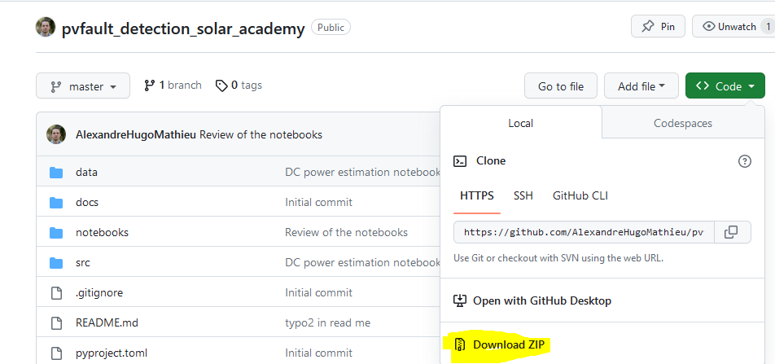
Appendix
How to install Python and import the course repository to use the notebooks on your local PC.
Install python: www.python.org/downloads/, download and install the 3.9.13 “release” (Add python to your Path)
Go to https://github.com/AlexandreHugoMathieu/pvfault_detection_solar_academy, click on the green “Code” button and then download the folder as the zip

Slide 60
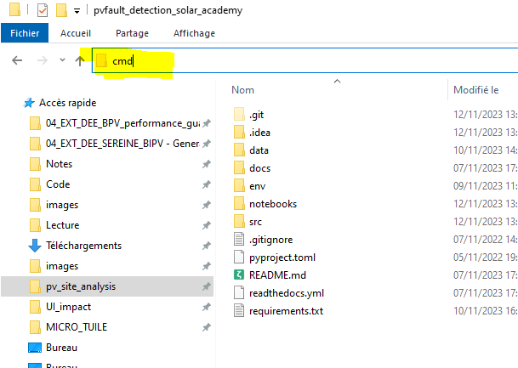
Appendix
How to install Python and import the course repository to use the notebooks on your local PC.
Install python: www.python.org/downloads/, download and install the 3.9.13 “release” (Add python to your Path)
Go to https://github.com/AlexandreHugoMathieu/pvfault_detection_solar_academy, click on the green “Code” button and then download the folder as the zip
Unzip it and put it in adequate location in your PC.
Let’s create a virtual environment where you will find all the functions for this course:
Go in the folder and open the command line from that same folder by writing “cmd” in the path bar (with Windows)

Slide 61
Appendix
How to install Python and import the course repository to use the notebooks on your local PC.
Install python: www.python.org/downloads/, download and install the 3.9.13 “release” (Add python to your Path)
Go to https://github.com/AlexandreHugoMathieu/pvfault_detection_solar_academy, click on the green “Code” button and then download the folder as the zip
Unzip it and put it in adequate location in your PC.
Let’s create a virtual environment where you will find all the functions for this course:
Go in the folder and open the command line from that same folder by writing “cmd” in the path bar (with Windows)
In the command bar: execute the following line to create the “solar_env” environnement, you will use in your notebooks
“pip install virtualenv”
“python –m virtualenv solar_env”
“call solar_env\Scripts\activate” (you should have a ‘solar_env’ on the left of the commande at this point)
“pip install –r requirements.txt” (load all the libraries, take a little time, be patient)
“python -m ipykernel install --name=solarkernel” (create a kernel for the notebooks)
It’s ready !

Slide 62

Appendix
How to start a notebook
Go in the folder and open the command line from that same folder by writing “cmd” in the path bar (with Windows)
In the command bar, exexute:
“call solar_env\Scripts\activate” (go in the virtual env)
“jupyter notebook” (open the notebooks browser)
3. Browse to the notebooks folder, choose one and pick the solarkernel when asked.

